Slide 1


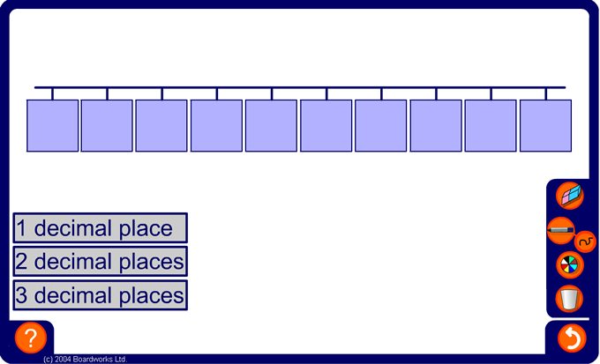


Decimal sequences
Notes:
The aim of this activity is to ensure that the pupils understand the positions of decimal numbers on a number line and that they are able to add (and subtract) small multiples of 0.1, 0.01 and 0.001 from decimals.
Start the activity by first establishing the size of the steps between each number. Ask pupils to tell you the values of the missing numbers (it is not necessary to do these in order). Press on an empty cell to reveal the number inside it.
Press on the number of decimal places required will generate a new number line.
Link:
A4 Sequences – continuing sequences.

